Slide 1
Configuring a LAMP
Web Development, Day 3
Cybersecurity Boot Camp |

Slide 2
Today’s Goals
By the end of class, you will be able to:
Install packages on an Ubuntu machine.
Configure the services required to run a LAMP server.
Analyze the security advantages/disadvantages of different server architectures.
Notes:
But today, we’re going to…
Review goals, address questions.

Slide 3
Overview and Setup

Slide 4
Overview and Setup
Most web servers on the Internet run on top of:
Linux operating system
Apache web server
MySDL database
PHP programming language

Slide 5
Overview and Setup
Most web servers on the Internet run on top of:
Linux operating system
Apache web server
MySDL database
PHP programming language
And these are the technologies most frequently targets in attacks against web servers.

Slide 6
Overview and Setup
Today, you’ll configure a LAMP server from scratch.
Why it will be helpful when you graduate:
What you’ll learn:
How services are installed / configured on a web server
Where crucial server configuration files are located
Where site files are stored.
Securing and auditing live websites
Performing penetration tests against web applications
Analyzing breaches of web servers

Slide 7
Package Management and nano

Slide 8
Package Management with apt
Linux users have their own version of Apple/ Windows Store called Personal Package Archives (PPAs).
PPAs are repositories that contain software that users can install.
Remember: Ubuntu uses a tool called apt which allows users to easily install and remove software from PPAs.
apt can also be used to:
Update sources/ ensure they’re downloading the most recent software available
Install packages
Update/patch packages
Uninstall/purge packages

Slide 9

Updating Sources
[Instructor Walk-thru]
Before running software, always ensure you’re downloading the most recent packages:

Slide 10
Installing packages:
[Instructor Walk-thru]
To install a package, run:

Slide 11
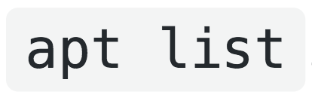
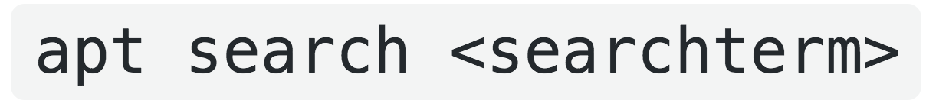
Listing Installed packages:
[Instructor Walk-thru]
You can see which packages you’ve installed by running
You can look for specific packages by running:

Slide 12
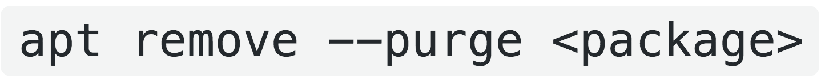
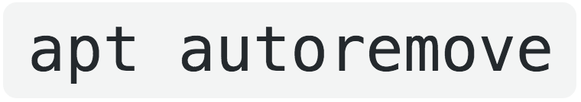
Removing Packages:
[Instructor Walk-thru]
Uninstall packages with:
After uninstalling a package, run:

Slide 13
Editing files with nano:
[Instructor Walk-thru]
After installing packages, you will often have to edit configuration files associated with the package.
nano is a simple command-line text editor useful for this task.

Slide 14
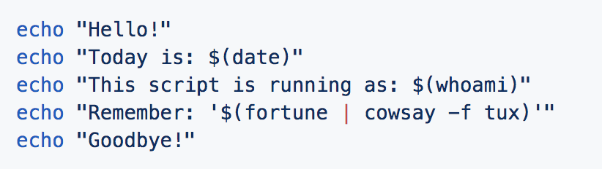
Editing with nano (Time)
Instructions:
Open a terminal and move to ~/Documents.
- Use nano to create a file called notes.sh.
  - Use the -u flag so you can undo/redo.
- Enter the following script:
- Practice undo/redo.
  - Press Alt + U to undo.
  - Press Alt + E to redo.
- nano has rudimentary cut/paste functionality.
  - Move to the middle of a line, and press Ctrl + K to cut the rest of the line.
  - Press Ctrl + U to paste the rest of the line.
- You can search for text with Ctrl + W.
  - Press Ctrl + W and search for echo.
  - Press Alt + W to go to the next search result.
  - Press Alt + Q to go to the previous search result.
- Save and exit when you're done exploring.
  - Press Ctrl + X; Y; then Enter.

Slide 15
Apache

Slide 16
The Apache Web Server
The A in LAMP refers to the Apache web server.
Apache is one of the most popular web servers, with over 75 million domains running some version of the server as of August 2018.
An Apache server runs on the Linux host and listens for HTTP requests on port 80.
Upon receiving a request, the service finds the resource on the local filesystem and sends it to the client

Slide 17
The Apache Web Server
Configure Apache in the following steps:
Add a Global Server Name to Apache's configuration file
with nano.
2. Verify the Configuration File with apache2ctl configtest
3. Start the server on system startup with systemctl

Slide 18
Apache’s Configuration file
Adding a Global Server Name to Apache's configuration file is required to help with DNS name resolution.
contains basic configuration settings for Apache, such as whether to allow keep alive connections

Slide 19

Apache’s Configuration file
Has the value:
A directive is a setting/option that can be configured.
This format is common to most server configuration files.

Slide 20
Installing Apache (0:15)
Instructions:
1. Install Apache using apt.
  The package is named apache2.
2. The next step is to update the Apache configuration with a ServerName. For our purposes, the ServerName should be your computer's public IP address.
  Find your public IP address using curl to send a GET request to http://icanhazip.com.
  Add the line: ServerName <Your Public IP Address>to the end of the file /etc/apache2/mods-enabled/dir.conf.
3. Restart Apache, and ensure the server starts on boot.
  Hint: Use sudo systemctl apache2 restart to restart. Figure out how to enable on startup yourself.
4. Next, update your UFW rules to use the Apache Full security profile.
5. Use cURL to send a GET request to http://localhost/index.html. You should see HTML!

Slide 21
PHP

Slide 22
Introducing PHP
While the Apache server is already capable of serving static files like index.html, CSS spreadsheets, and images…
More complex functionality such as database interactions and user registration require a programming languages.
For that functionality, we have PHP.
(a.k.a PHP Hypertext Processor)
(a.k.a. the P in LAMP)

Slide 23
Introducing PHP
PHP is a server-side programming language, meaning that it’s a programming language that runs on the web server.
PHP is used by over 78% of websites whose programming language is known.
This means the majority of sites targeted by hackers run PHP applications.

Slide 24
The Accessibility of PHP
PHP was built specifically for processing web pages:
Simply write PHP in a text file;
Serve that file from Apache;
Then, it will generate an HTML web page automatically.
By contrast, other languages (Python, Java, etc.) require you to configure a framework, implement your own server logic, etc.
However, PHP is declining in popularity while languages like Python, JavaScript and Ruby are gaining traction.

Slide 25
Installing and configuring PHP (0:10)
Instructions:
Install the following packages with apt: `php libapache2-mod-php php-mysql`
2. Update Apache to load index.php instead of index.html.
  Edit the file: /etc/apache2/mods-enabled/dir.conf
  Find the line that starts with: DirectoryIndex
  Move index.php before index.html.
  Save the file (in nano, press Ctrl + X).
3. Create a file to test your PHP installation in /var/www/html/info.php.
It should contain the line: <?php phpinfo(); ?>
4. Open a browser and navigate to http://localhost/info.php.
5. Finally, remove /var/www/html/info.php.

Slide 26
MySQL

Slide 27
Introducing MySQL
The last component of LAMP we’ll cover is MySQL, which is the database for storing application data.
Remember: A database is a system used to store and retrieve large amounts of data overtime.
MySQL allows users to store and organize large amounts of data, which can be easily requested by other services.

Slide 28
Introducing MySQL
Like PHP and Apache, MySQL is one of the most popular technologies on the web…
Unlike Apache, MySQL typically doesn’t listen to requests from clients like a web brower/ user-end.
Instead MySQL works as follows:
A client requests data through an application
The application service receives the request
The service requests the data from MySQL
MySQL responds to the service with data
The application service responds to the original client with data

Slide 29
Security and Databases
Data-bases are usually attacked because they contain sensitive information, such as user credentials.
The two most common categories of attacks are:
SQL Injections: attackers “trick” web applications into retrieving sensitive data
Vulnerability Exploits: attackers who have hacked into the MySQL server itself attack the MySQL service directly.

Slide 30

Security and Databases
While protecting against SQL injections is a job for developers, network security specialists can protect against exploits by running MySQL Secure Installation script after installing the database:
This command launches a series of prompts that help the user configure strong passwords, reset default credentials, etc.

Slide 31
Installing and configuring MySQL (0:15)
Instructions:
Install and configure MySQL using apt and mysql_secure_installation.
Questions:
The secure installation process prompts you to change various defaults. In this series of questions, you'll think critically about why:
Why should MySQL disallow queries from non-local services?
What are the advantages to disabling remote login to the MySQL shell? What are the disadvantages?
What are the security implications of not deleting the default test table?

Slide 32
Server Architecture

Slide 33
Security and Databases
While we now have configured both Apache and MySQL on our server, it would be unwise to keep the database and application/ webserver on the same machine in real deployment, due to:
Security, Scale, Deployment
Running MySQL and Apache on different machines will improve:
Safety, Redundancy, Flexibility in Scale

Slide 34
Architectures
Alternative arrangements of machines / servers are called architectures.
A “good architecture” solves problems like:
Handling a huge number of users connecting at a tie (e.g. Facebook)
Transferring a large amounts of data quickly (e.g. Youtube)
Sudden need to add complex new features

Slide 35
Type of Architectures
Familiarity with basic server architectures is important because different architectures has unique advantages / disadvantages.
Types of Architecture include:
Single Host
Dual Host
Web Farm without Database Cluster
Web Farm with Database Cluster
Web Farm with Application Servers
Web Farm with Load-Balanced Application

Slide 36
Single Host
In a single host setup, a single host runs both the web server and the database.
Advantages: Simple to set up
Disadvantages: Doesn't scale; insecure (compromising a single host compromises the whole application); single point of failure (if the host goes down, the entire app does too)

Slide 37
Dual Host
In a dual host setup, one host runs a web server, and another runs a database. The web server makes requests to the database server when it needs data.
Advantages: More secure than a single host architecture;
Disadvantages: Still doesn't scale well; still insecure (compromising the HTTP server compromises most of the application); still has a single point of failure (if either the HTTP server or database goes down, the application does, too)

Slide 38
Web Farm without Database Cluster
In a web farm, requests go through a load balancer, then to one of many web servers. The web servers then make requests to the database.
Advantages: Scales better; Availability is improved (if one HTTP server goes down, the other can pick up slack)
Disadvantages: Only slightly more secure than the previous architectures. This setup has better Availability, but its Confidentiality and Integrity are the same.

Slide 39
Web Farm without Database Cluster
In a Web Farm with Application Servers, requests go through a load balancer; then to a Web Server, which handles HTTP requests; and then from the Web Server to an Application Server, which is another server that figures out how to fulfill the HTTP requests.
Advantages: Much more secure than previous setups (two firewalls make it hard to gain access to sensitive data)
Disadvantages: Complicated, since you have to set up two firewalls and separate application servers from web servers

Slide 40
Web Farm without Database Cluster
In a Web Farm with Application Servers Same as the previous architecture, but with a load balancer in front of the application servers.
Advantages: Same as for Web Farm with Application Servers.
Disadvantages: Same as for Web Farm with Application Servers.

Slide 41
Design Problems (0:20)
In this exercise, you'll consider the security implications of different server architectures.
Questions
In the case of a single host running both an HTTP and DB server, an attacker can compromise the entire system by compromising the single host.
1. Consider the Web Farm (without database cluster).
Which servers might an attacker target to steal data?
Which servers might an attacker target to DoS the application?
2. Consider the Web Farm (with database cluster).
Explain one way a database cluster might be more secure than using a single database.
  (Hint: You can store different data in different places.)
How does the CIA of a Web Farm with database cluster compare to that of a Web Farm without one?
3. Consider the Web Farm with Dedicated Application Servers.
Which servers would an attacker need to compromise to steal sensitive data?
Is the Web Farm with Dedicated Application Servers more or less secure than the Web Farm with Load Balanced Application Servers?

Slide 42
Review
Review

Slide 43
Today’s Goals
By the end of class, you will be able to:
✅ Install packages on an Ubuntu machine.
✅ Configure the services required to run a LAMP server.
✅ Analyze the security advantages/disadvantages of different server.
architectures.
Notes:
But today, we’re going to…
Review goals, address questions.

Slide 44
Fin

